Slide 2

CONTACTLESS CARTON COUNTING
IN WAREHOUSES (MID-TERM)
DAMANVIR SINGH

Slide 3
CONTENTS
Background
Problem Statement
Solution (MVP)
Approach-1
Algorithm
Future Work
Q&A

Slide 4
BACKGROUND
Carton counting is a task mostly done manually in warehouses by labor.
Manually doing this task is expensive because of:
Labor costs
Time taken to count all cartons on pallets, and
How error-prone manual counting can be
Amazon.com delivered approximately 3.5 billion packages in 2019. Expected to deliver approximately 6.5 billion packages by 2022.
With an error of just 1% (industry rate is 2-5%), around 35 million packages were not delivered properly on time.

Slide 5
INTENT
DESIGN A SYSTEM FOR
CONTACTLESS CARTON COUNTING IN WAREHOUSES
THROUGH COMPUTER VISION AND MACHINE LEARNING
6

Slide 6
SOLUTION (MVP)
A viable solution that can detect cartons on pallets and count them accurately, will involve both computer vision (CV) and machine learning (ML).
The solution will work in the following manner:
Take multiple pictures from different angles of the pallet with cartons.
Do carton detection on the images and return an accurate total for the number of cartons on the pallet being counted.

Slide 7
APPROACHE-1: What we wanted to achieve?
Basic carton detection on a simple image of cartons on a pallet, where the image is only a front view image to exclude the complexity of angles.
Input: Image
Output: Carton detection & Number of cartons on the pallet
The image on the right is our test image.

Slide 8
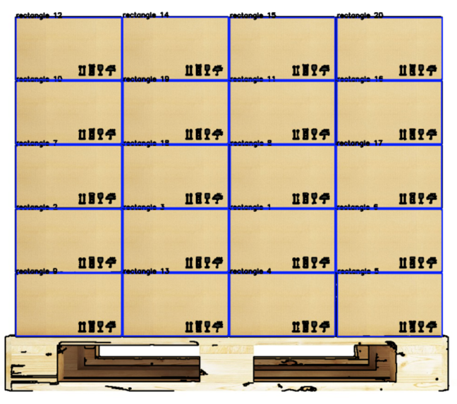
APPROACHE-1: Result

Slide 9
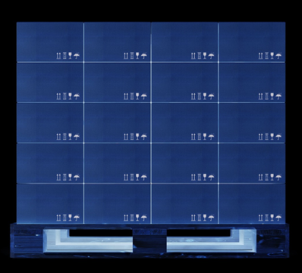
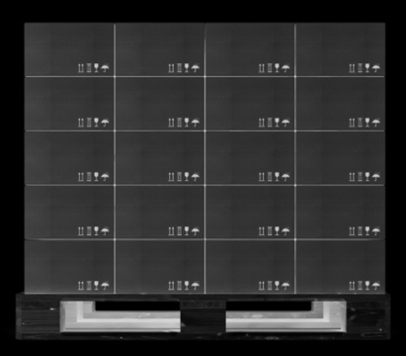
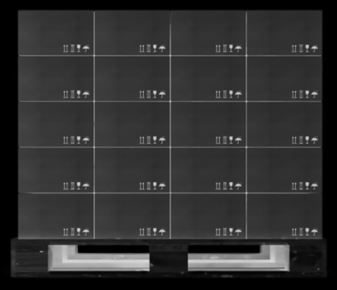
APPROACHE-1: Algorithm
Step 1:
Bitwise Invert
Step 2:
Grayscale
Step 3:
Blur

Slide 10
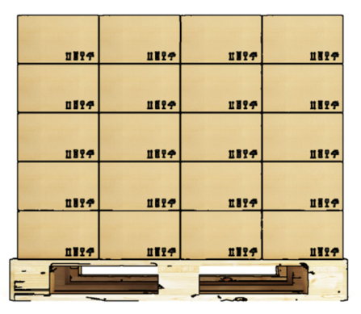
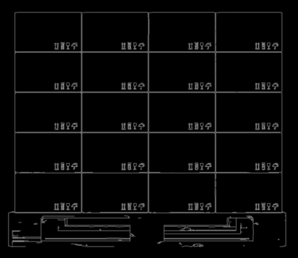
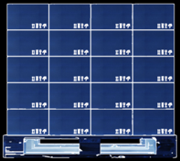
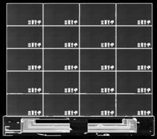
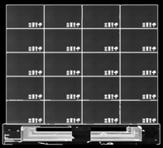
APPROACHE-1: Algorithm (continued…)
Step 4:
Edge Analysis
Step 5:
Overlaying Edges
Step 6:
Repeat Steps 1-4

Slide 11
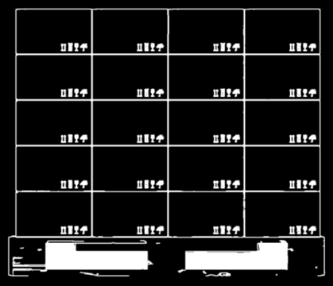
APPROACHE-1: Algorithm (continued…)
Step 7:
Threshold Analysis
Step 8:
Shape Detection
(Carton Detection)

Slide 12
NEXT STEPS
Step-2: The shape detector will be re-designed as an ML Classifier, which will be more accurate in terms of determining if a shape is a carton or not.
Step-3: Determining the total number of cartons on a pallet through multiple images of the pallets from different angles.
Step-4: Detect and scan barcodes on cartons to further determine what the carton includes and in what quantity, along with using the carton’s dimensions to validate our algorithm’s carton counting.

Slide 13
APPENDIX
https://www.pexels.com/photo/wooden-pallets-1684989/
https://techcrunch.com/wp-content/uploads/2018/12/GettyImages-825338394.jpg?w=730&crop=1
https://axisindustrialsolutions.com.au/media/catalog/product/cache/1/image/9df78eab33525d08d6e5fb8d27136e95/p/a/pallet_cartons.jpg
https://www.pexels.com/photo/brown-wooden-pallets-635096/
https://www.pexels.com/photo/photo-of-white-and-brown-cardboard-box-toy-figure-678308/

Slide 14
HAVE A GOOD DAY! ☺

